Slide 1
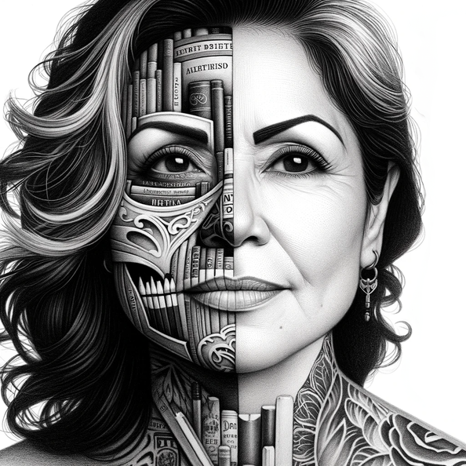
Librarians and Their Feral Kin

Slide 2

Feral Librarians

Slide 3
Guerilla Librarians
“Feral,” or “guerilla” librarians instrumental in forming a new librarianship
Too often these innovators must fight against protectionism.
Not advocating:
Against library science education
Devaluing of degrees
Calling for a ruthless examination of the function of LIS education

Slide 4
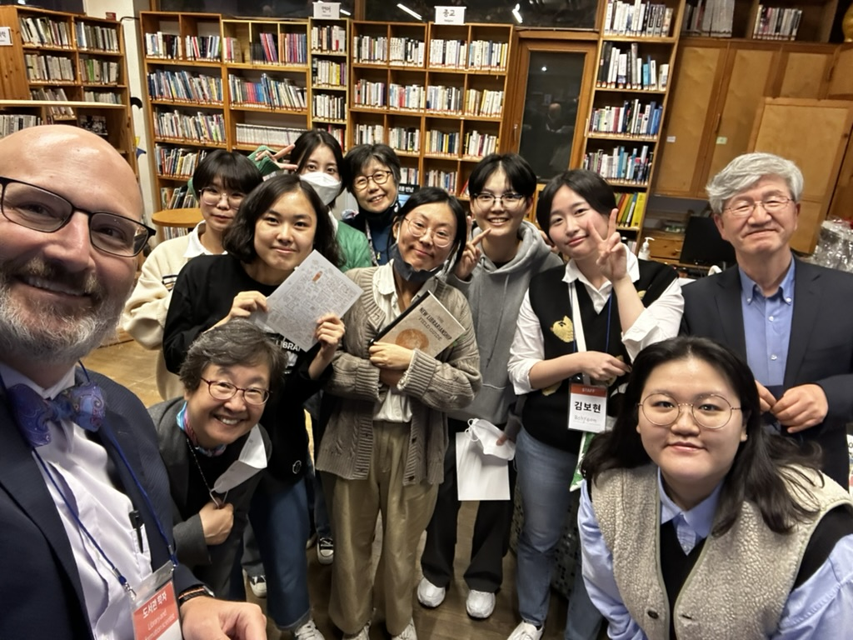
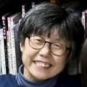
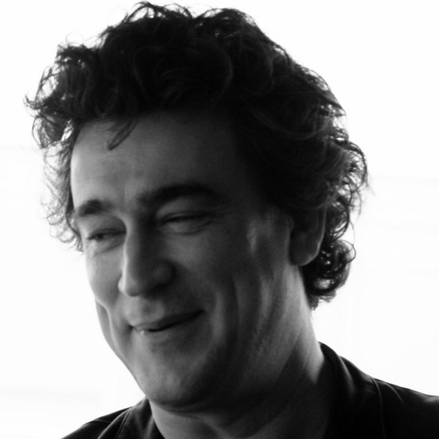
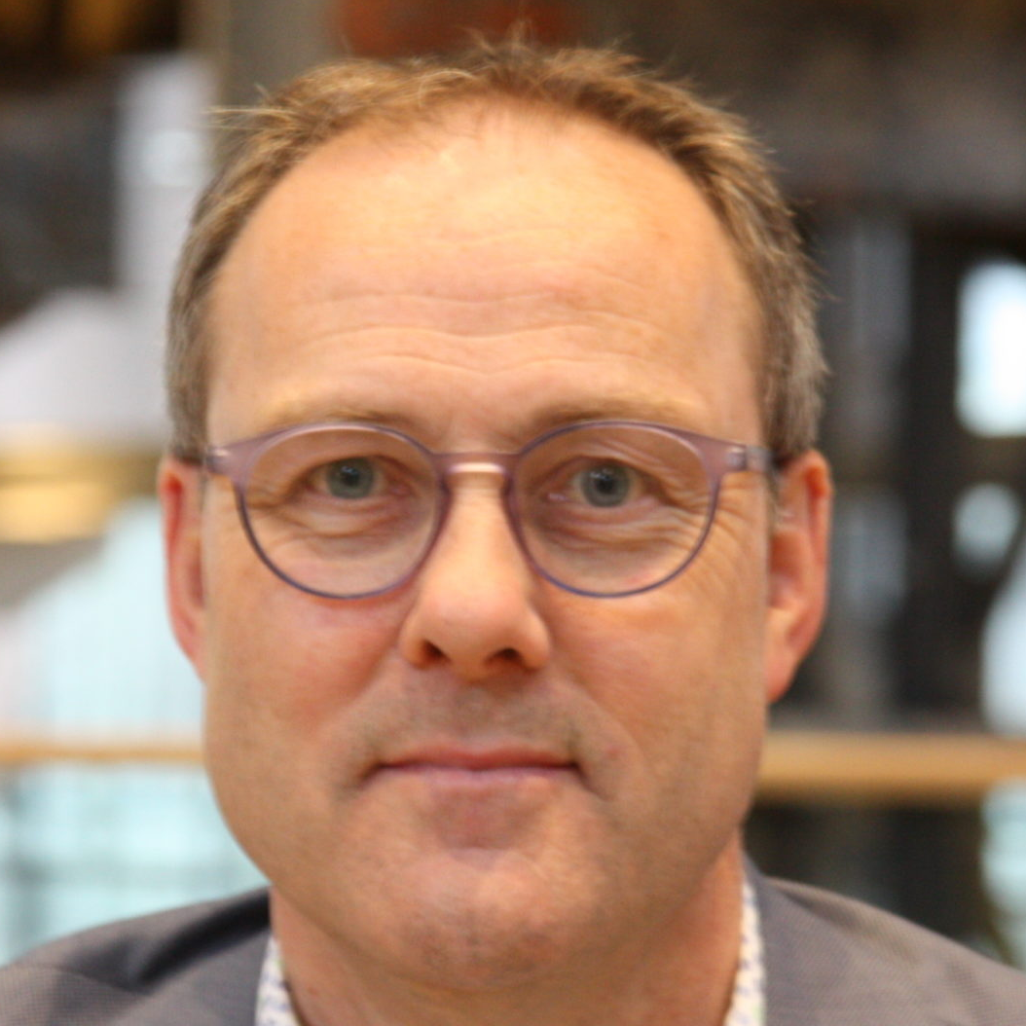
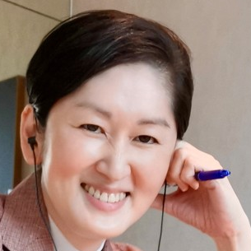
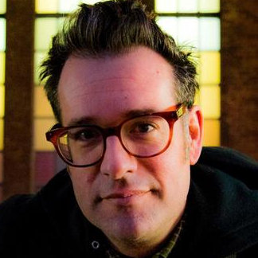
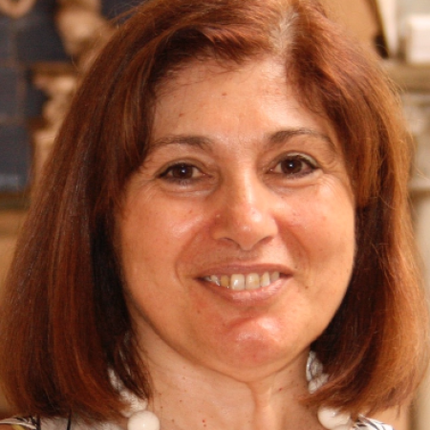
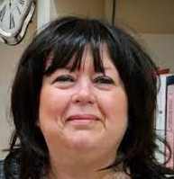
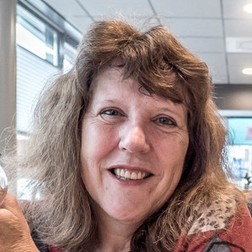
Seeing Value in Actions

Slide 5
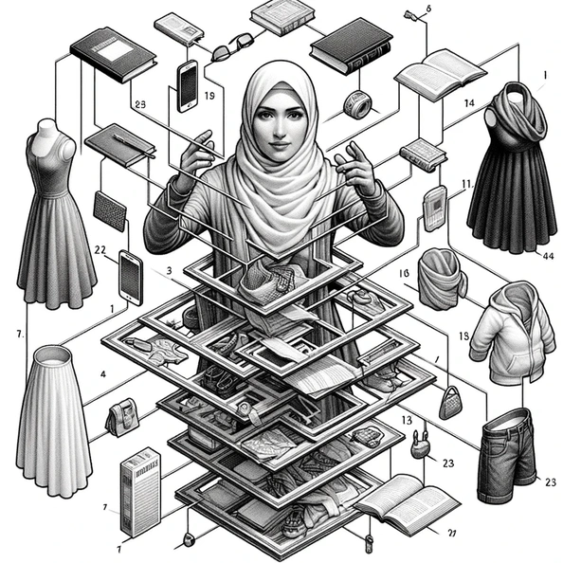
Library Education
Positive:
Impart necessary ideas and practice
Research
Advocacy
Negative:
Instruments of inertia
Against some limiting norm.
Other ways to the crucial mission for the public good

Slide 6
Definition of a Librarian
Mission
MISSION: The mission of librarians is to improve society through facilitating knowledge creation in their communities
Means
MEANS: Access, Knowledge, Environment, Motivation
Values
VALUES: Learning, Openness, Diversity, Intellectual Honesty (not Unbiased), Intellectual Freedom and Safety
LIBRARIAN
Notes:
So let me distill 17 years of research into 1 slide.
However, all of this depends on one word: knowledge
I know I’ve been asked to be very practical, but my approach to librarianship that some call community some call new and I just call it librarianship, is all about the why, because the how is going to be different community by community.

Slide 7
What Makes a Librarian?
MISSION: The mission of librarians is to improve society through facilitating knowledge creation in their communities
MEANS: Access, Knowledge, Environment, Motivation
VALUES: Learning, Openness, Diversity, Intellectual Honesty (not Unbiased), Intellectual Freedom and Safety

Slide 8
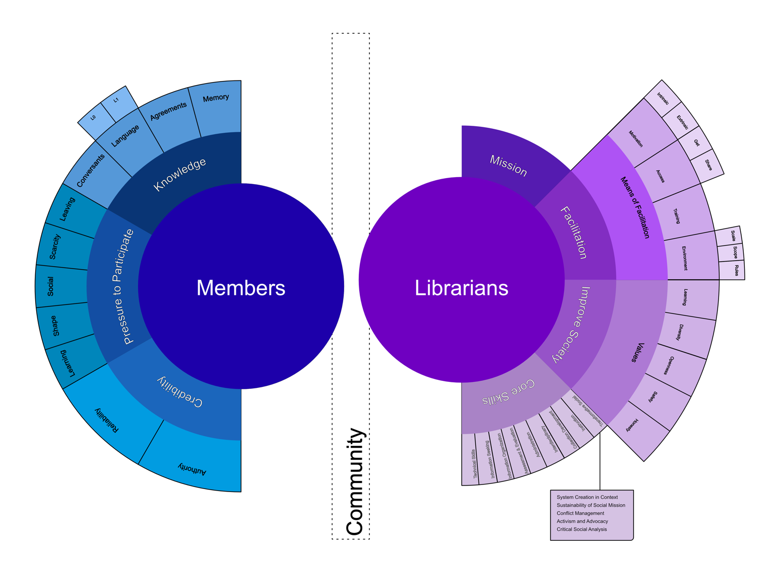
Influencing Members

Slide 9
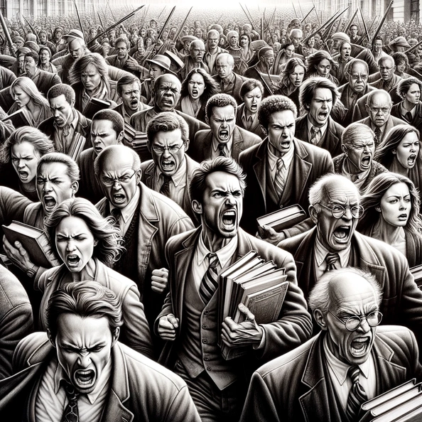
Why Do We Need to Define Librarian?
Long-standing stress:
technological disruption, health crises, climate change, and the changing demographics of the people we serve.
Libraries are being asked to do more:
A push for greater inclusion; to support programs to lift people from poverty,
Librarians are called to do more, like save lives.

Slide 10
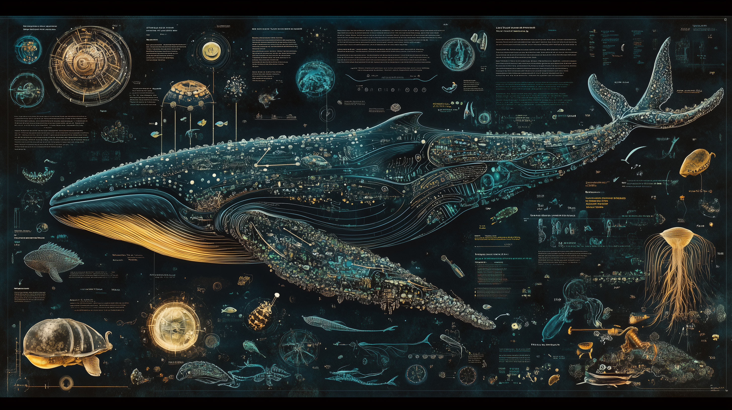
Keystone Species

Slide 11



Who is a Librarian?
Someone who holds the mission, means, and values of librarianship

Slide 12
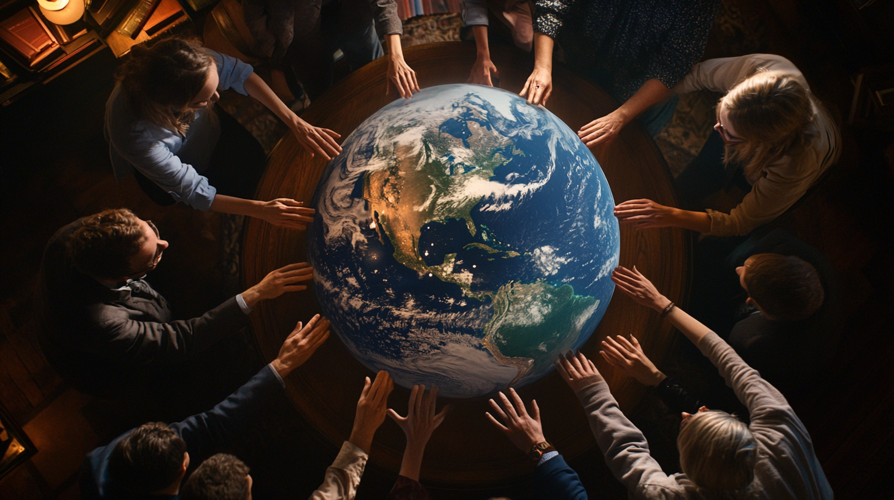
Think Globally

