Slide 1
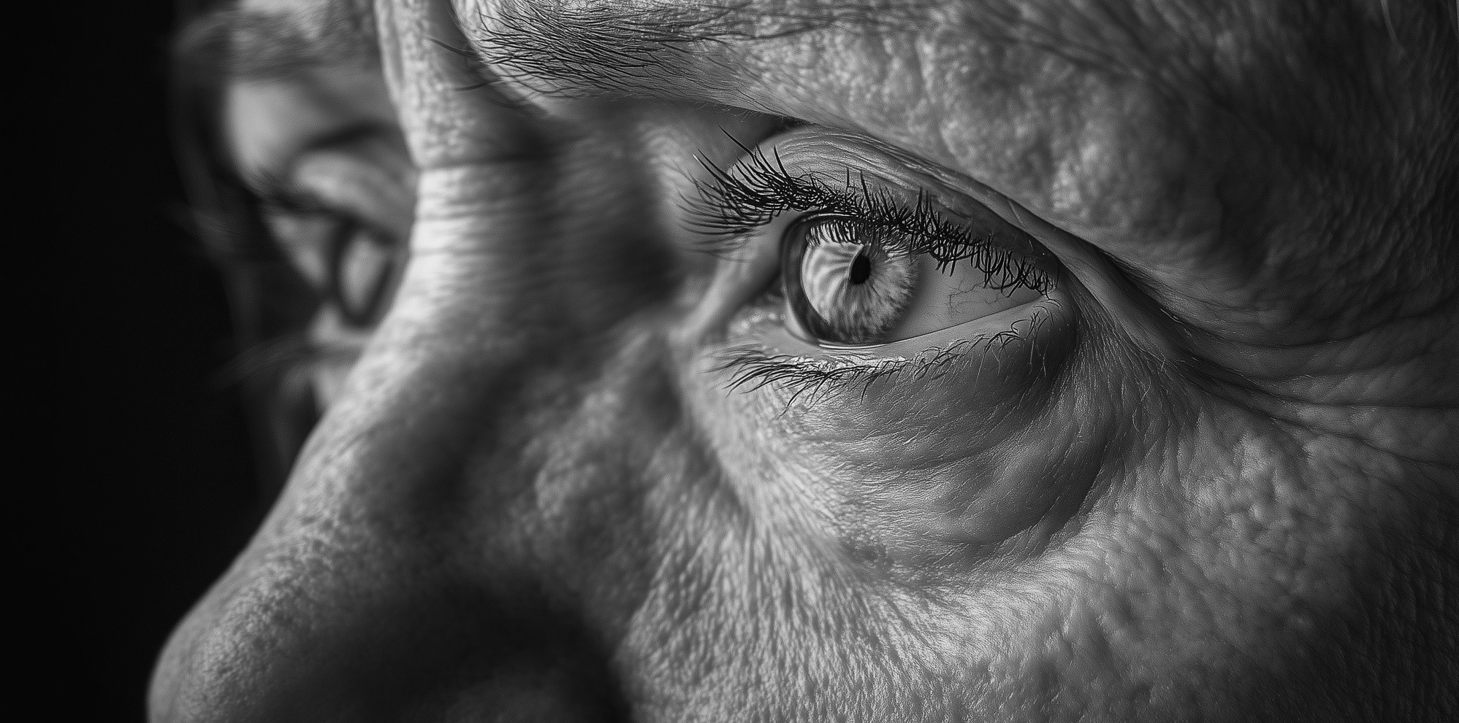
From Serving to Saving

Slide 2
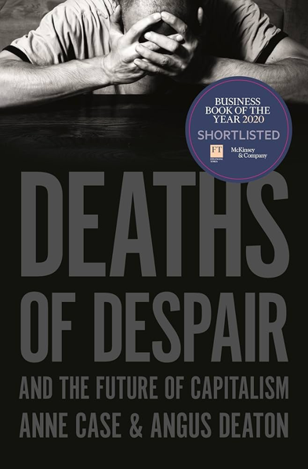
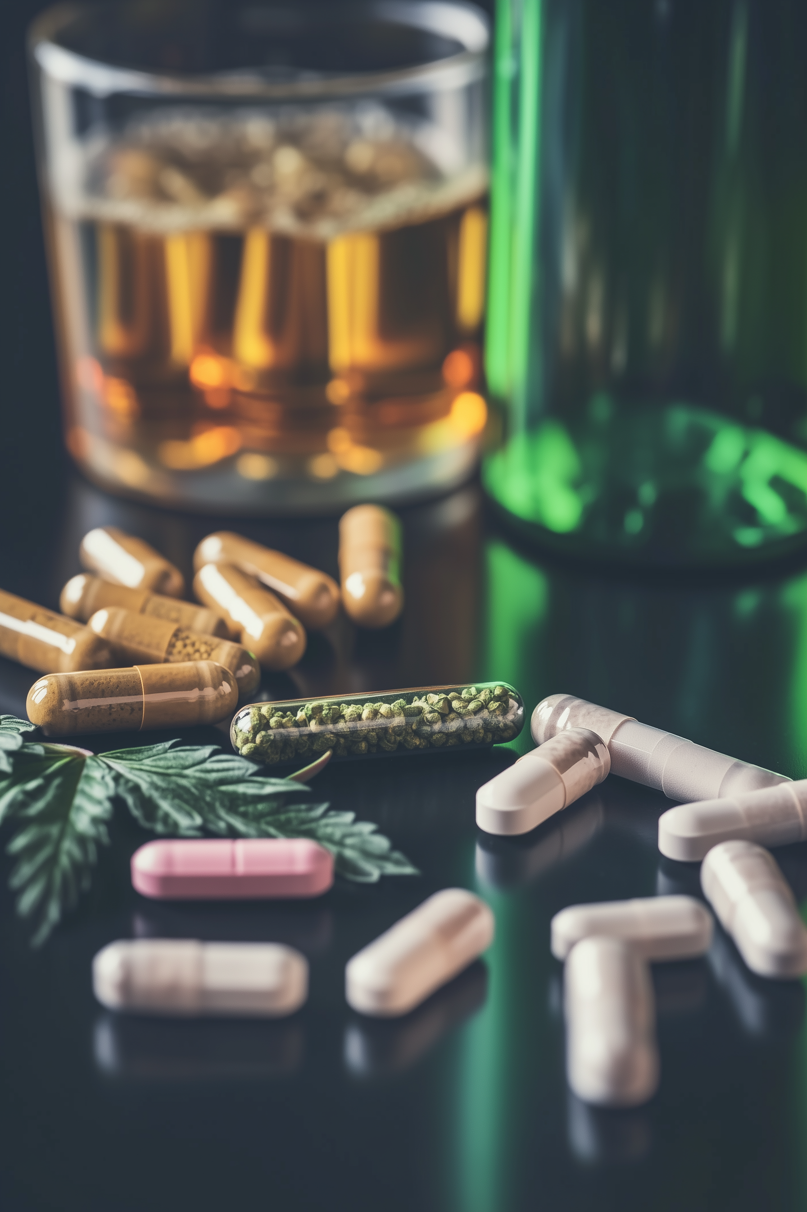
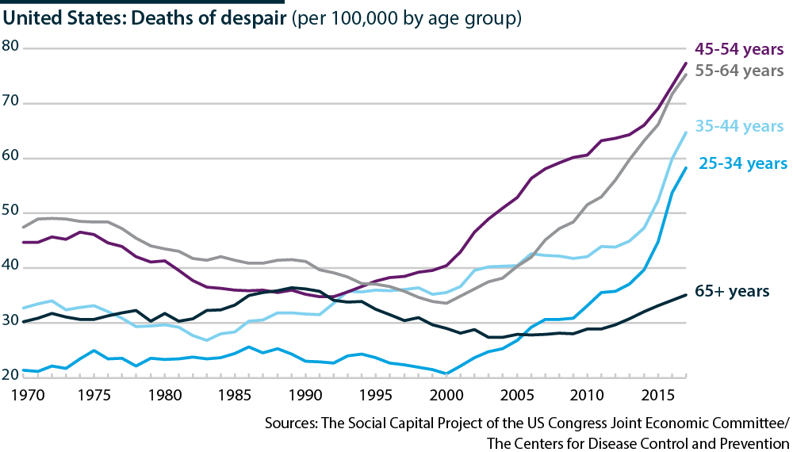
Deaths of Despair
“The mortality impact of being socially disconnected is similar to that caused by smoking up to 15 cigarettes a day”

Slide 3
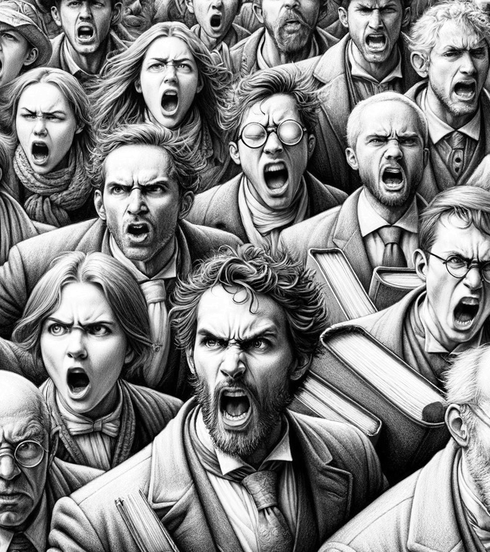
Narratives
Storytelling is part of being human
Stories over our best interests
Confirmation bias

Slide 4
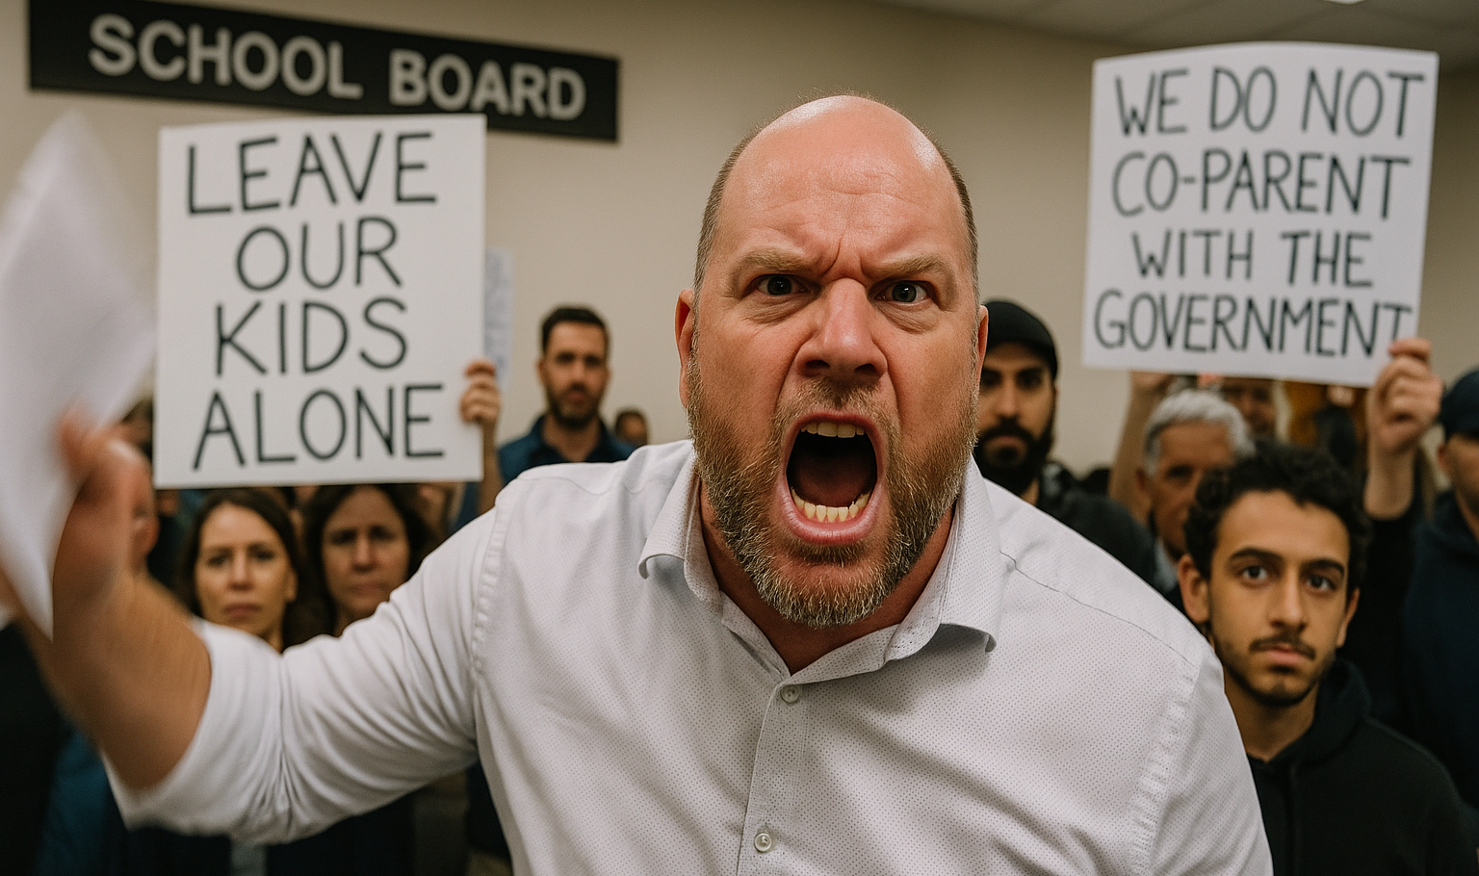
Librarians Under Attack

Slide 5
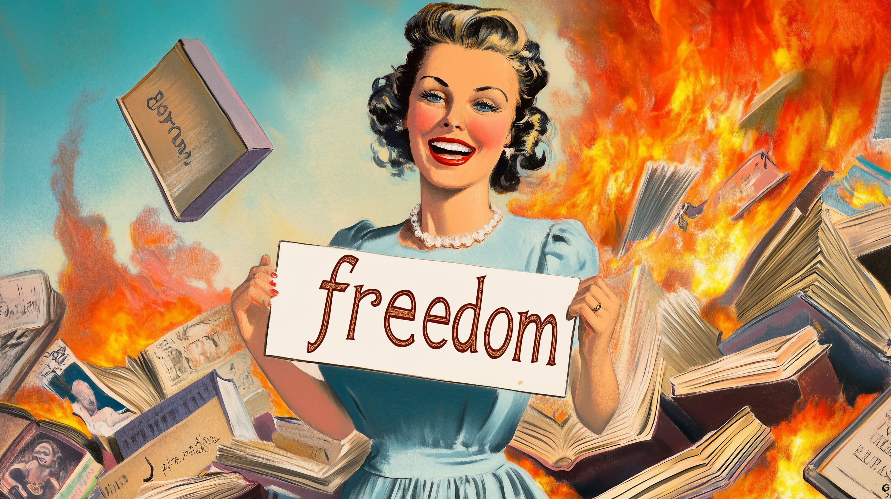
Book Banning Mask
Countering
“Parents”
Right
Narrative

Slide 6
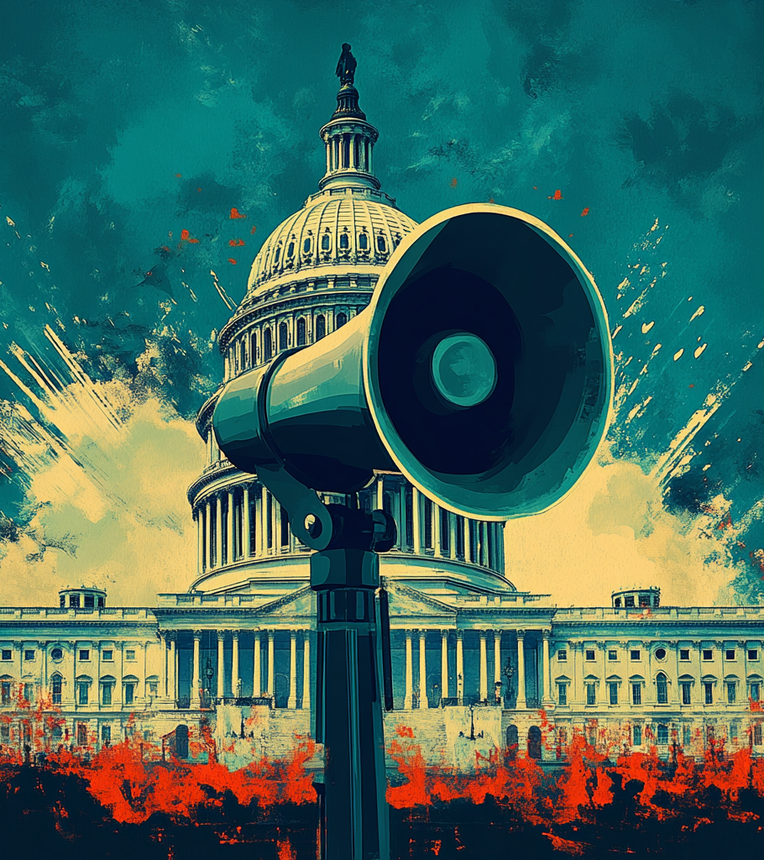
Government Speech
Presented as Not censorship
  bypasses the first amendment
Success of this narrative could cripple libraries

Slide 7
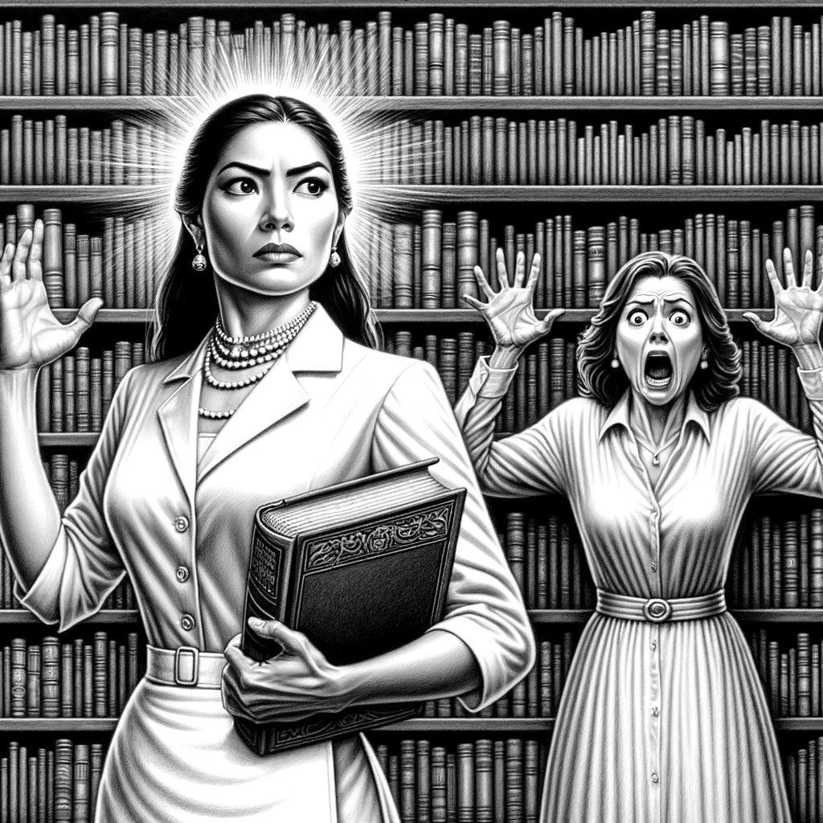
Never Neutral
Old Narratives
  Neutrality
Newer Narrative
  Professionalism
Book Bans can Start Small
  Tens can activate hundreds to restrict access for thousands

Slide 8
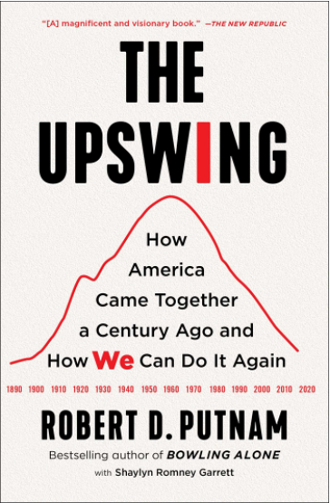
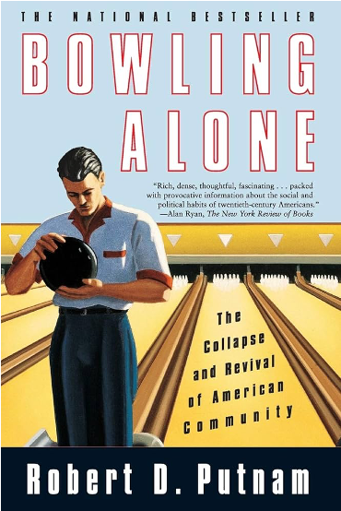
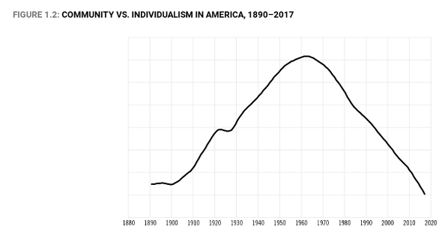
Social Cohesion
The I/We curve where members of a society focus on themselves and their wellbeing (I) versus where a community comes together around common goals (We).

Slide 9
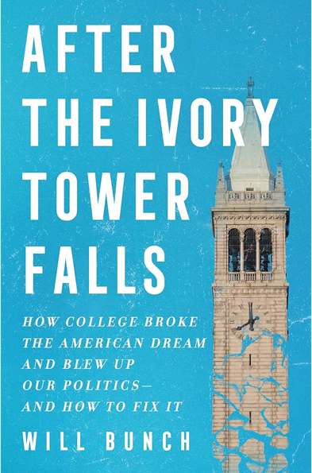

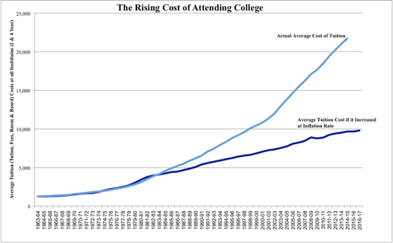
Social Cohesion
The I/We curve where members of a society focus on themselves and their wellbeing (I) versus where a community comes together around common goals (We).

Slide 10

Conflict to Classroom (to Conflict)
One does not build strong social systems on dopamine hits and enraging people
Destabilizing the underlying social connection is the act of self-destruction

Slide 11
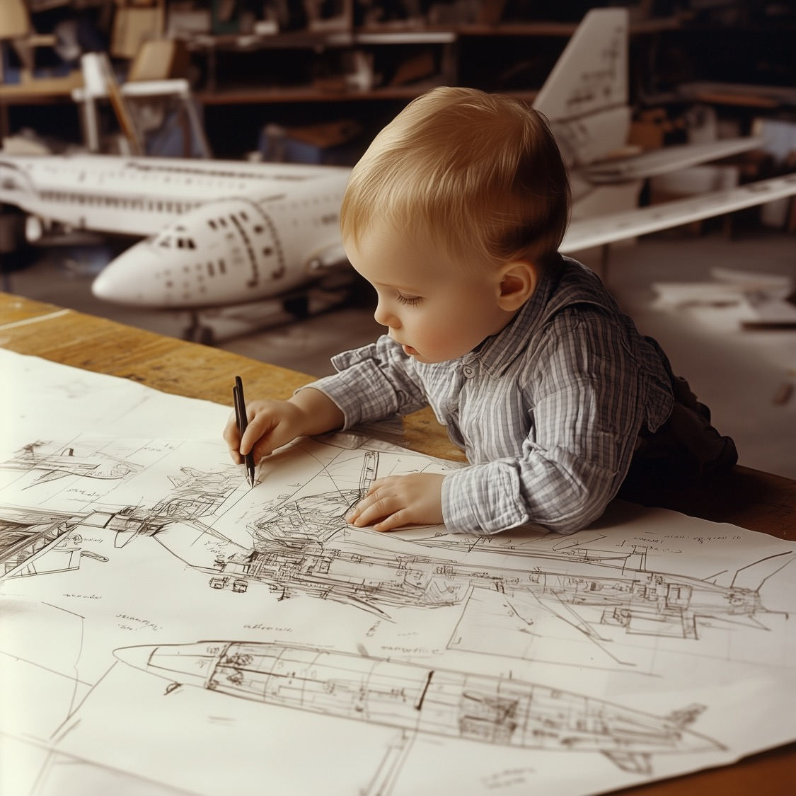
From Phonics to Flying
Librarianship and Information Science are neither separate fields nor do they need to move to some homogeneous new field

Slide 12
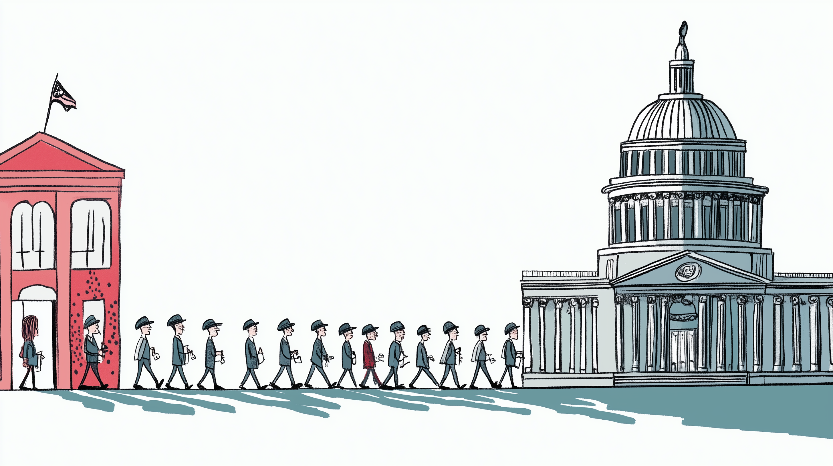
Lessons to Action
a civil society encourages the sharing and debate of ideas, especially those we disagree with
and everyday experience of ethically connecting people to information and that was sorely needed in the state houses.

Slide 13
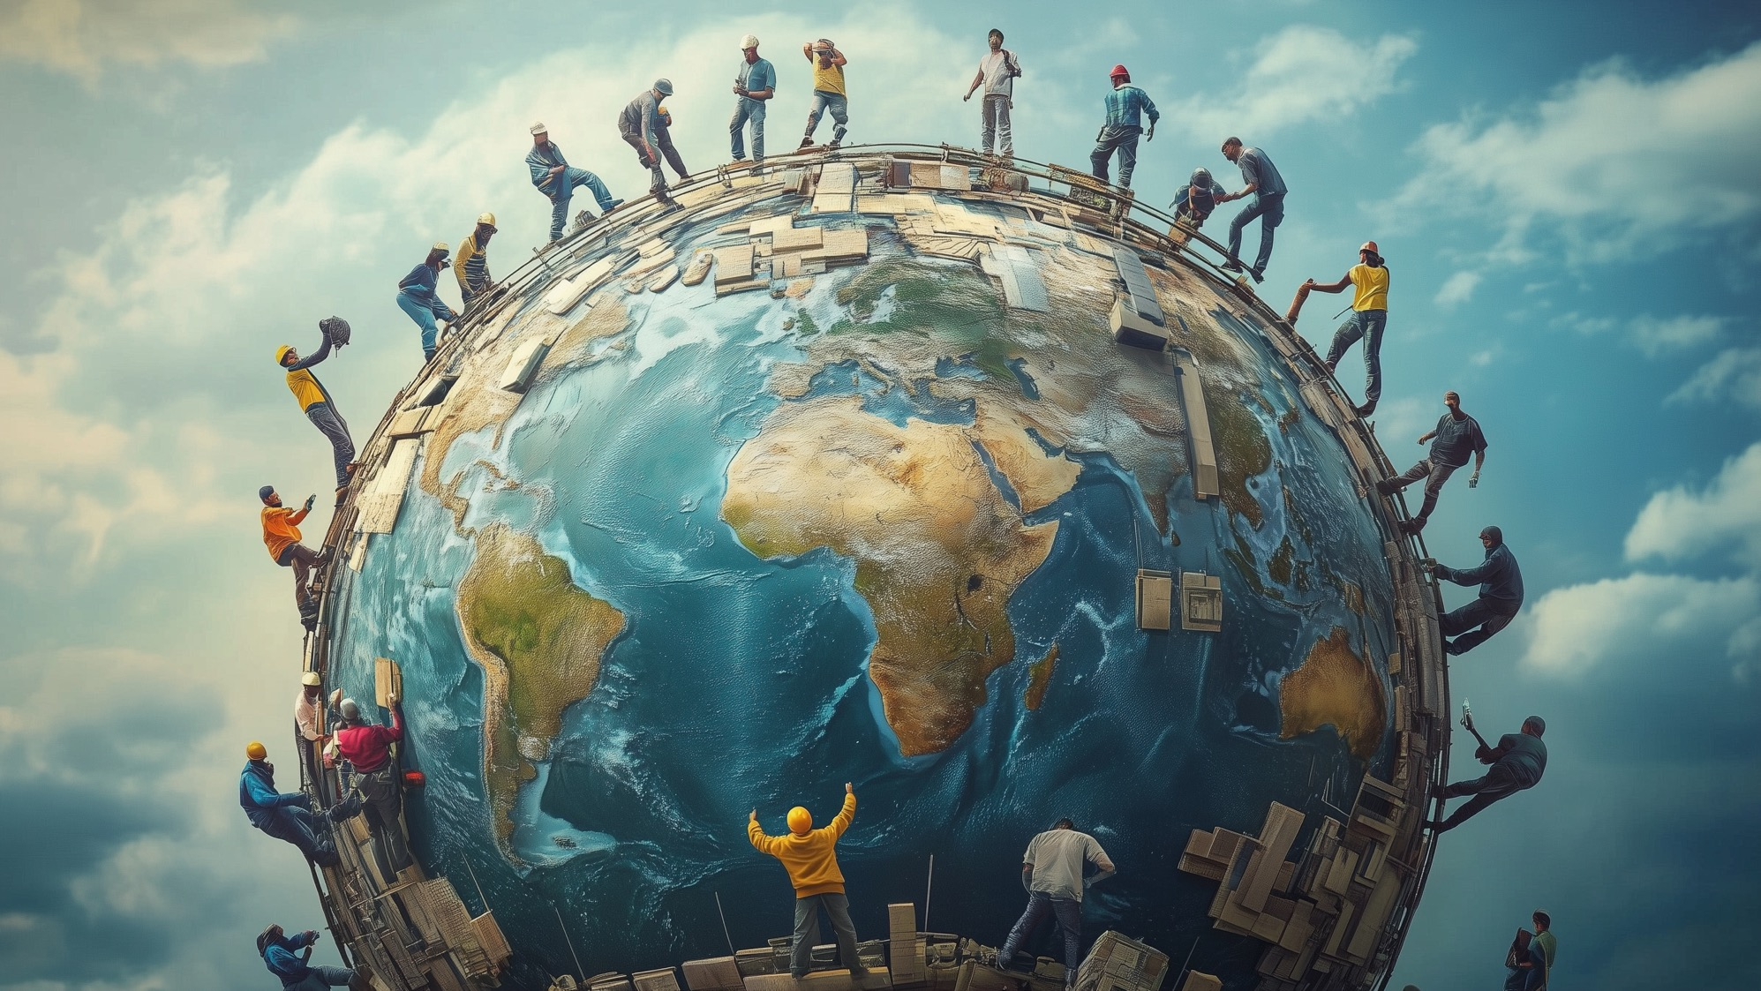

Slide 14
