Slide 1
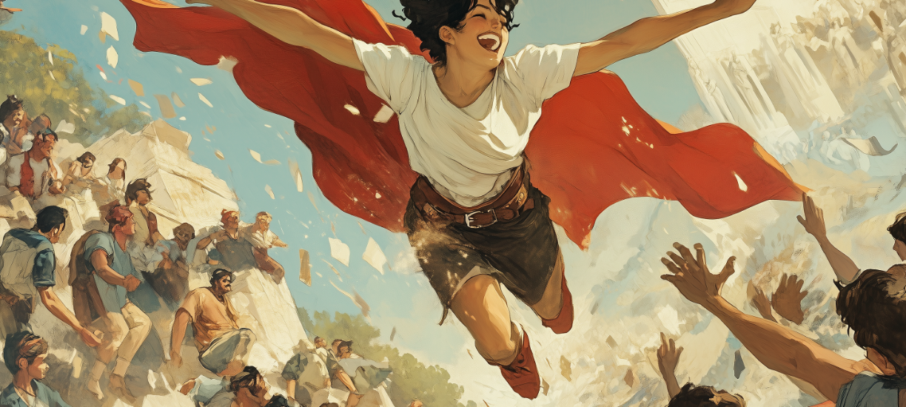
AI, Joy, and Social Connectedness

Slide 2
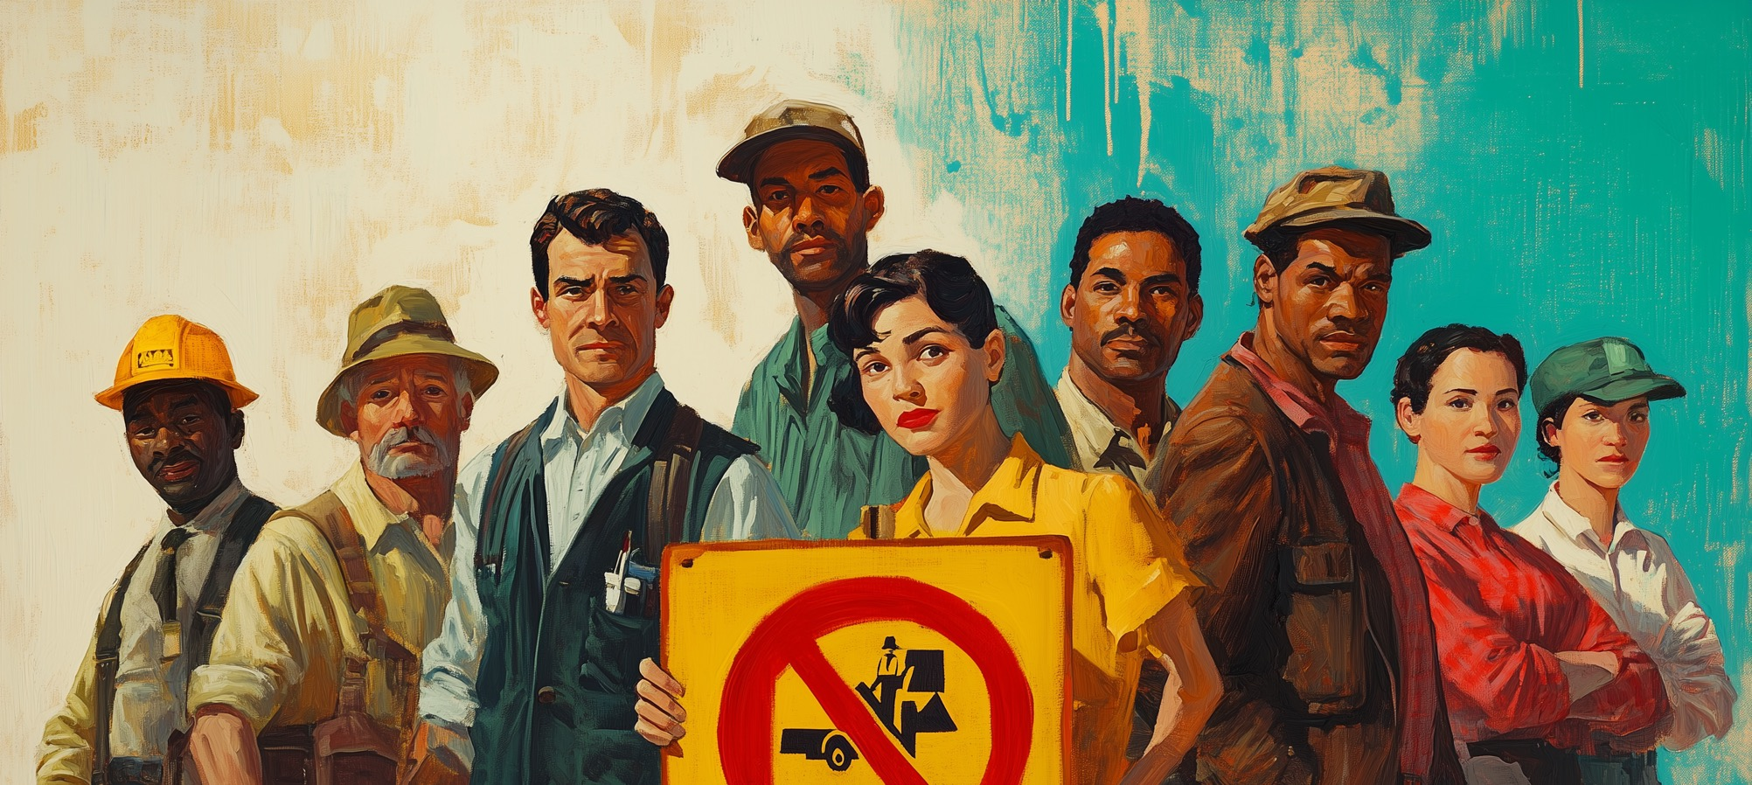
Vocational Awe: A Warning
Fobazi Ettarh, Vocational Awe and Librarianship: The Lies We Tell Ourselves

Slide 3

An Apology
Libraries and library staff are facing multiple challenges in an age of artificial intelligence, climate crisis, war, questions on the firmness of democracy, book bans (and literal book burning), disinformation flooding social media, social media pushing confrontation over community for greater monetization, mounting deaths of despair from growing social isolation, and pandemics. But these challenges offer libraries an opportunity to serve our communities wrestling with such massive issues and help them find optimism and room for growth.

Slide 4

Joy
A Great Opportunity to Positively Change Society.
We must acknowledge problems and then act. We act in our own local way at our own local scale.

Slide 5

The Two Faces of the Industrial Library
Doom: Toolkits and Best Practices for Mass Adoption
  Rural Mental Health Example
Dream: Transformed Networks of People not Functions
  Instead of a focus on standardizing functions
  Focus on library staff sharing ideas and learning the adapt, not adopt those ideas.
Notes:
The day of the single toolkit and best practice solution is over. The long lingering model of efficiency and industrial librarianship put forth in the days of dewey are at an end.

Slide 6

The Two Faces of AI
Doom: As a disruptive force and one in a series of escalating technological shifts
  AI is here: music, cars, health
  Generative AI impacts publishing, education, creative work
Dream: As a tool to augment the work of librarians and to help communities tell stories
  Accessible to unskilled voices to tell their authentic story: scripting, images, narration
  Augmented Intelligence in Reference
  Putting stories to work – accessible qualitative data

Slide 7

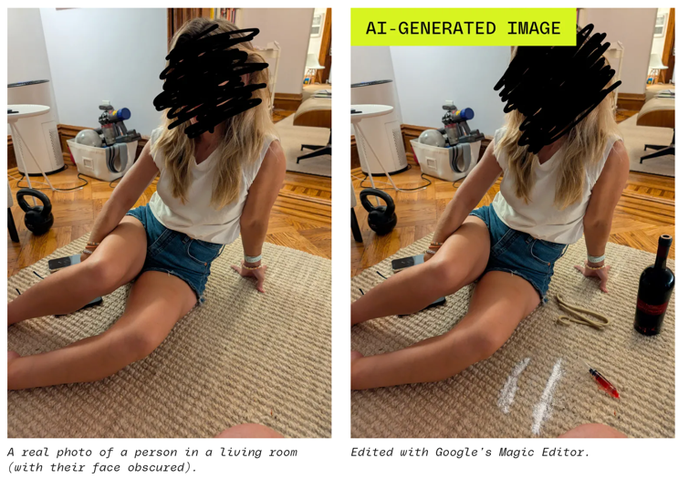
The Two Faces of AI – Part 2
Doom: All information in doubt
  Pictures no longer assumed to be reality
Dream: Position hyper-local information expertise to authenticate information and hold local authority
  A new information literacy is needed
  From making people skeptical to the stress of always being skeptical

Slide 8
Deaths of Despair: A Glorious Tragedy
Old Narratives
Neutral Retreat
Information Center
Third Space
New Narrative
Agents of Social Connection
Saving Lives
From Passive 3rd Space to Active Ground of Engagement

Slide 9
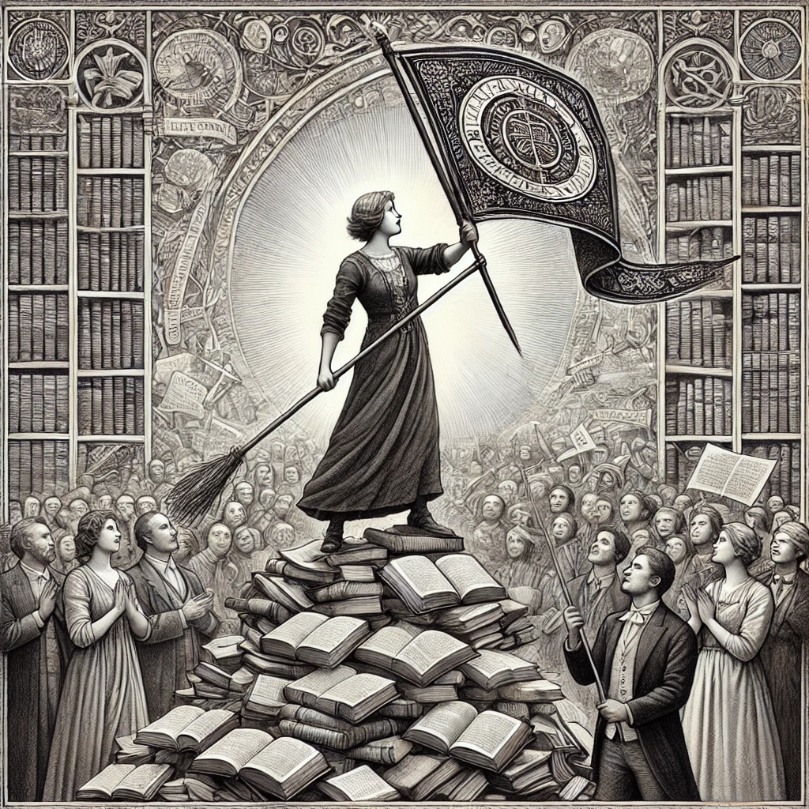
Two New Models
The Library as Movement
The Library as Storyhouse

Slide 10
Plan for Joy
We must prepare our staff and ourselves | We must infuse optimism through action | Act locally and share share share | Insist on networks of ideas and conversation instead of standards and functions | Play side-by-side with the community

