Slide 1
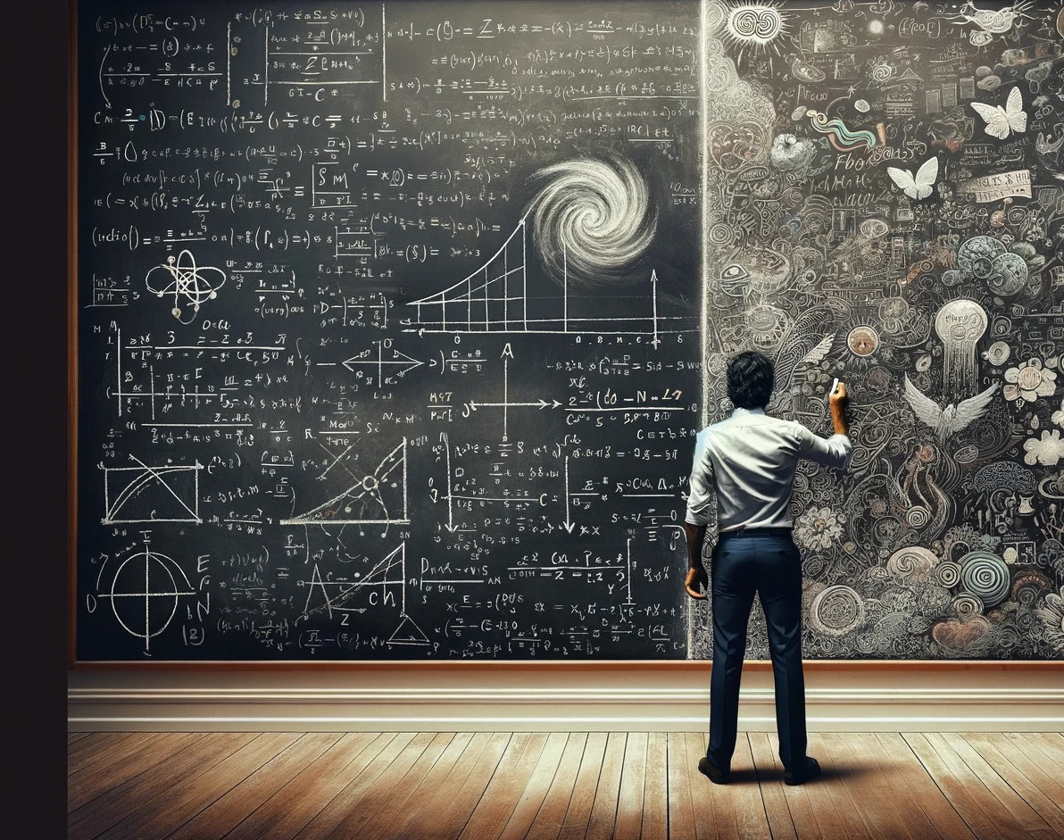
Developing a Library Strategic Response to Artificial Intelligence
A SLAAIT Briefing

Slide 2
Participating Agencies
Texas State Libraries and Archive Commission
Georgia Public Library Service
State Library of Iowa
New Jersey State Library
Colorado State Library
Washington State Library
Hawaii State Public Library System
Delaware Division of Libraries
New York State Library
State Library of North Carolina
Arizona State Library
Tennessee State Library and Archives
Library of Michigan
State Library of Ohio

Slide 3
SLAAIT Overview
What is Artificial Intelligence?
State Interviews
Training & Competencies,
AI Competencies (what librarians and staff need to know to know)
DREAM
DREAD
DECONSTRUCT
Synthesis of perils and possibilities from member conversation

Slide 4
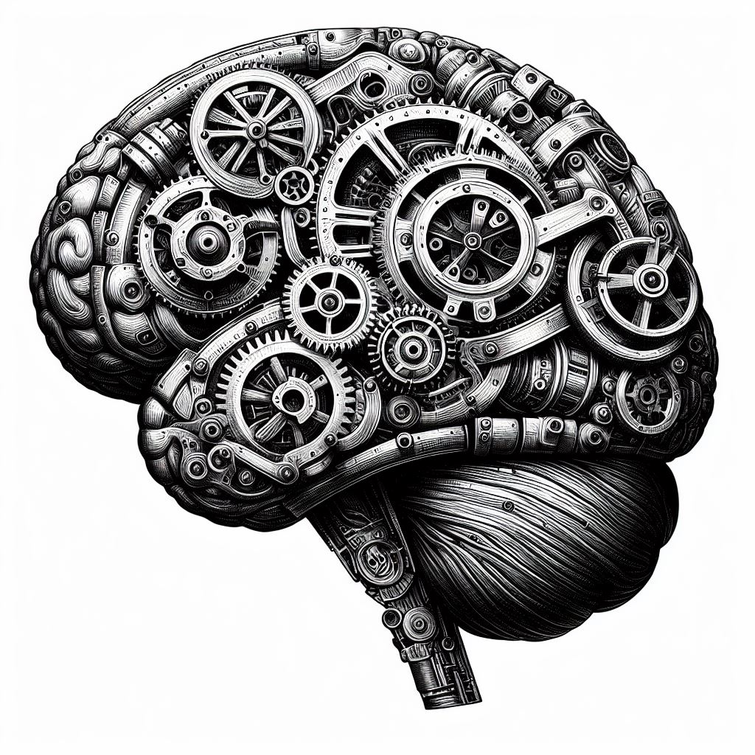
What is AI?

Slide 5
The Hydra: The Many Heads of AI
One body (machine learning plus big data) but many instantiations
Highly visible: generative AI and LLM
The invisible: AI in search, music, fitness, cars

Slide 6
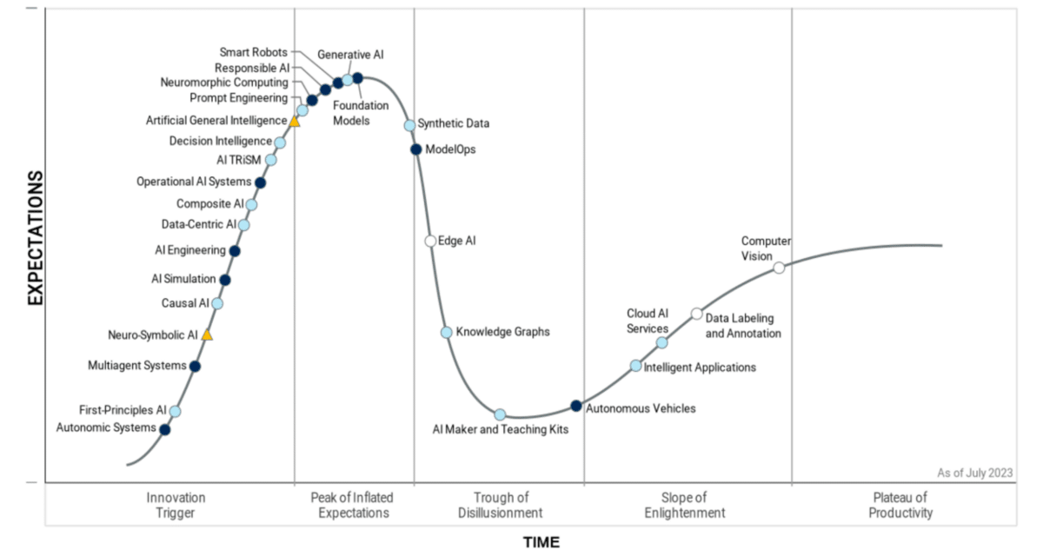
AI, the Hype Cycle, and the Art of Distraction

Slide 7
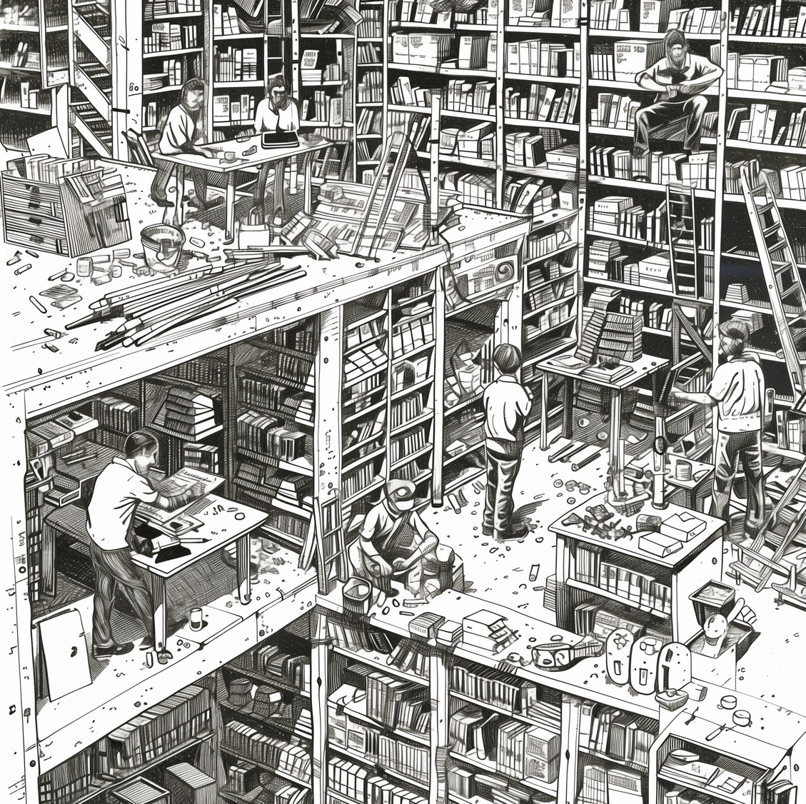
Concerns of Member States

Slide 8
State Themes
AI in the Library Workplace:
Training and Education
Job Impact
Tool Accessibility
AI in the Community:
Digital Literacy and Inclusion
Misinformation and Disinformation
Public Education and Resources
Workplace Restrictions:
Policy and Governance
Ethical Considerations

Slide 9
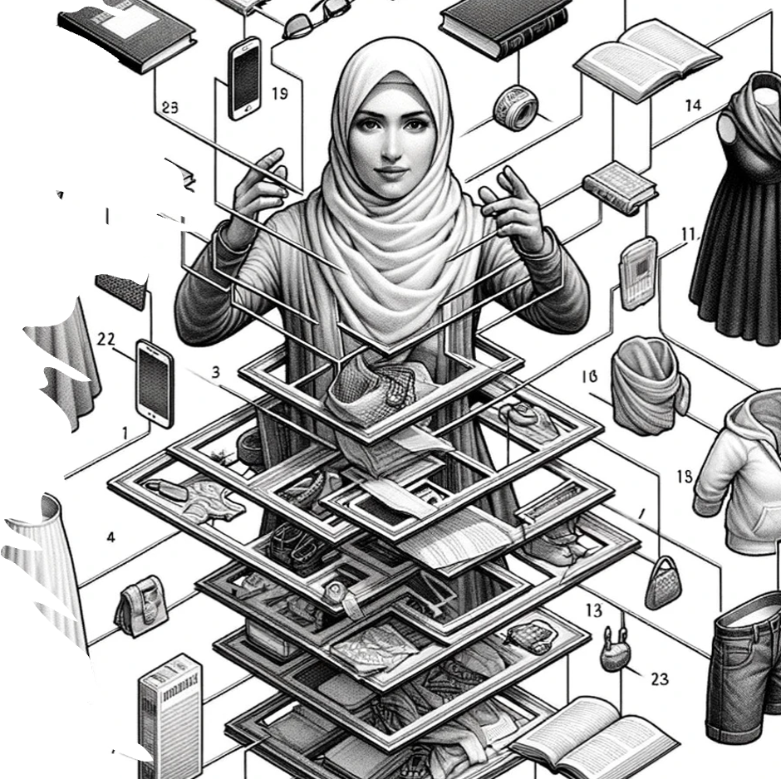
AI Competencies
What librarians and staff need to know to know

Slide 10
Librarian Roles and Skills
Are of Knowledge | Function | Skill
Data | Diverse Data Sets, Privacy, Intellectual Property, Data Stewards, Data Hygiene, Ontological Development | Data Literacy, Ontology, Policy, Research Skills
Algorithms | Advocate for Explainable AI | Facilitation, Community Engagement
Machine Learning | Training, Hallucinations, Diverse Test Sets, Evaluation, Transparency | Project Management, Evaluation
Application | Participatory Design, Advocate for Equitable Access | Training, Evaluation, Advocacy, Access

Slide 11
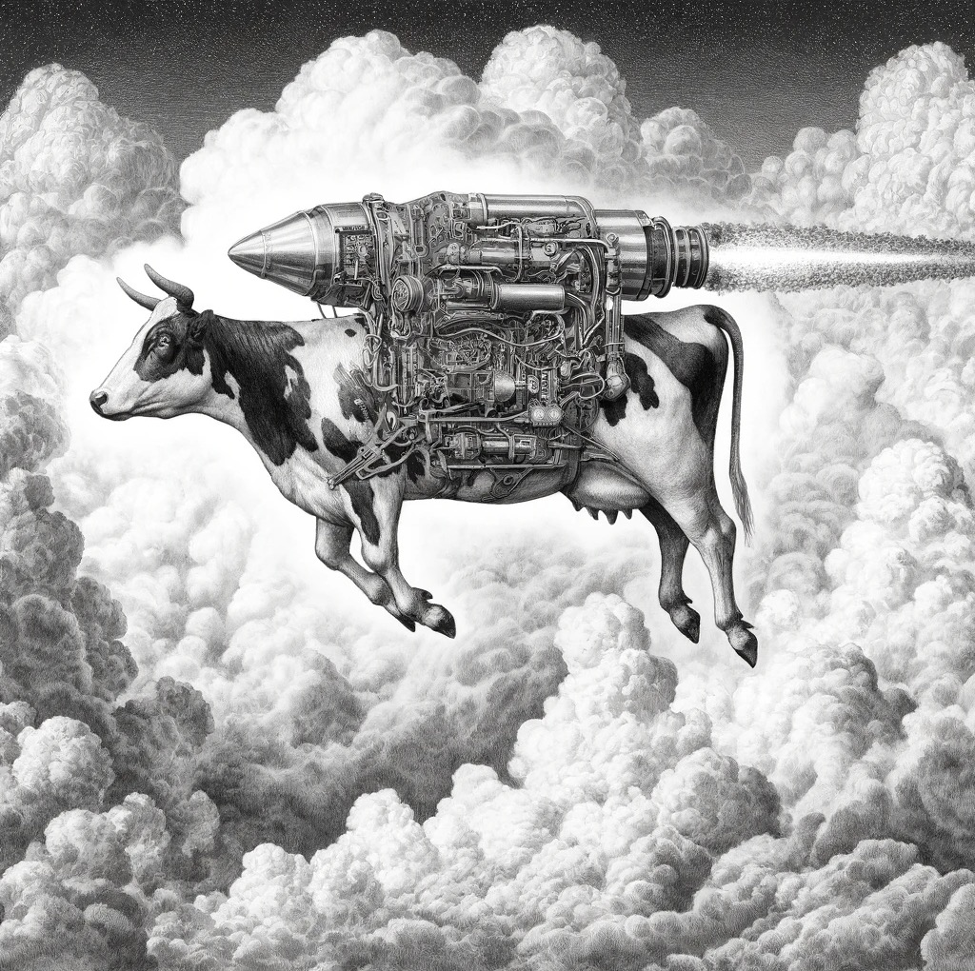
Dream

Slide 12
Ideas and Approaches
The reality of “Augmented Intelligence” where the librarian can use AI to increase impact.
The need for a national public AI infrastructure and the role of libraries
The use of generative AI to facilitate community story creation and sharing
How AI tools can help all voices in a community tell their authentic story
The use of Large Language Models (such as ChatGPT) in analyzing qualitative data (written feedback for example) and in evaluation

Slide 13
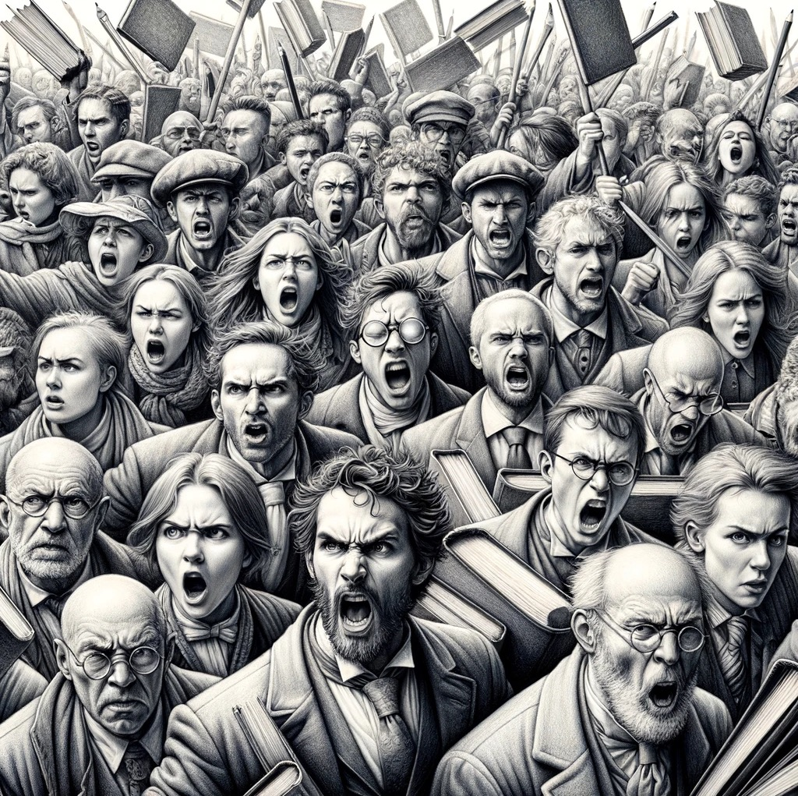
Dread

Slide 14
Questions
Does AI threaten library jobs?
Corrosive AI – the potential threat of AI generated disinformation to public institutions and democratic processes
Ethics and LLM original sin
Use of AI in censorship
Overwhelming Production (Amazon Books, Literary Journals, Scholarly Publishing)

Slide 15
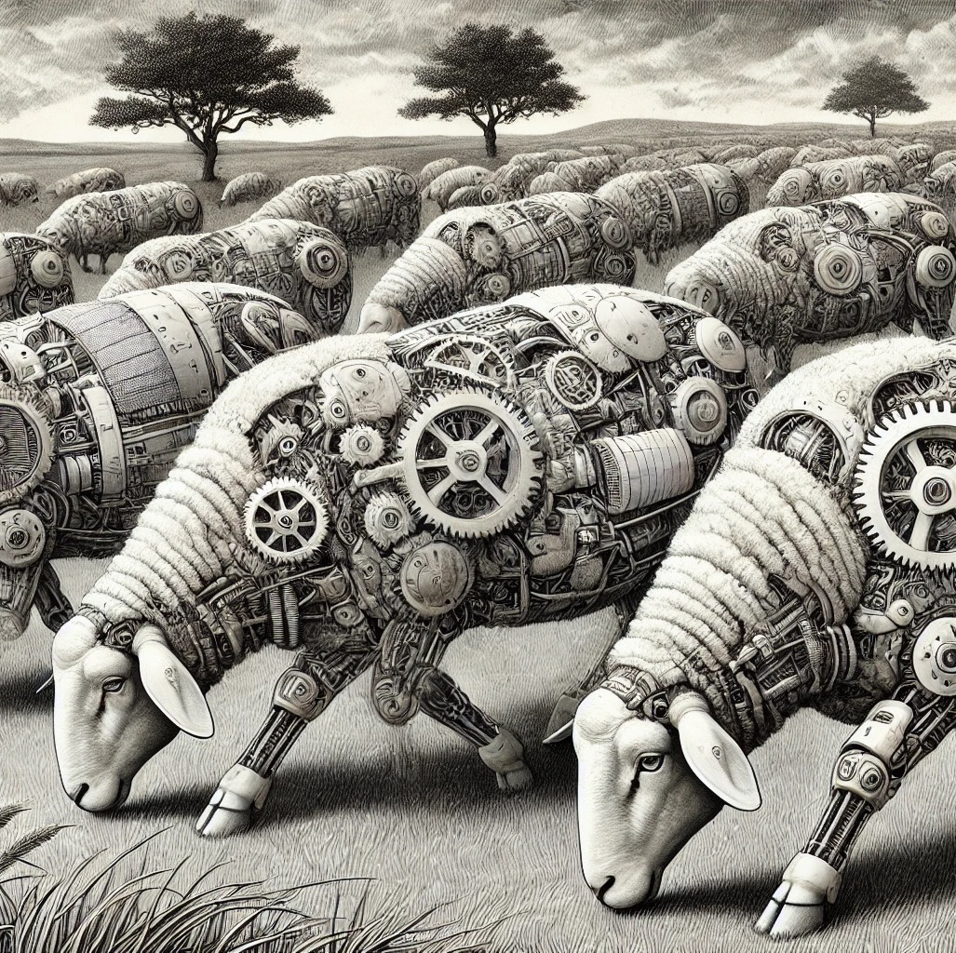
Deconstruct
AI Petting Zoo

Slide 16
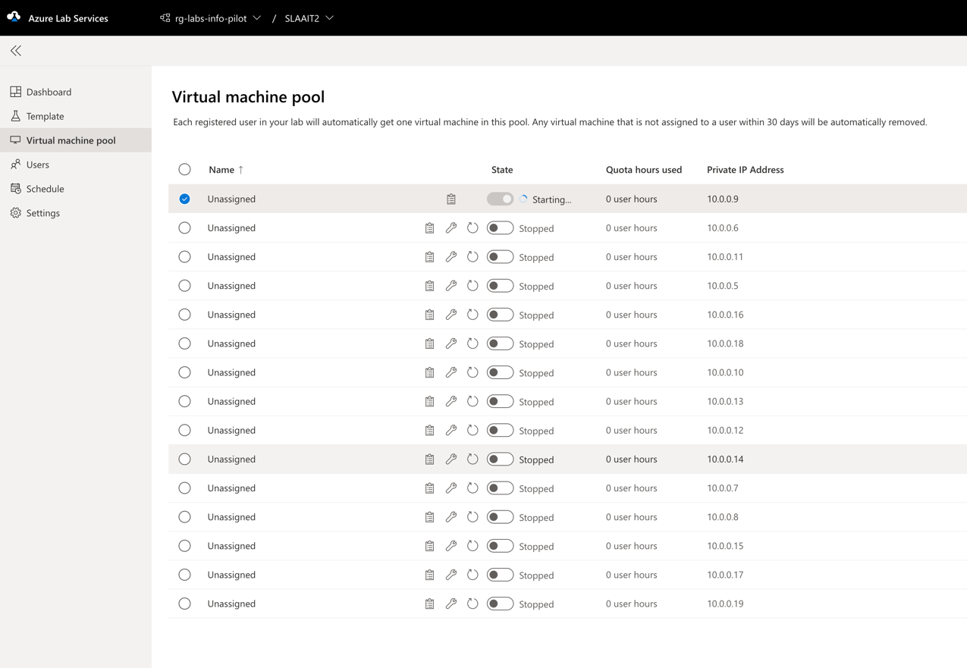
AI Petting Zoo: A Virtual Learning Lab

Slide 17
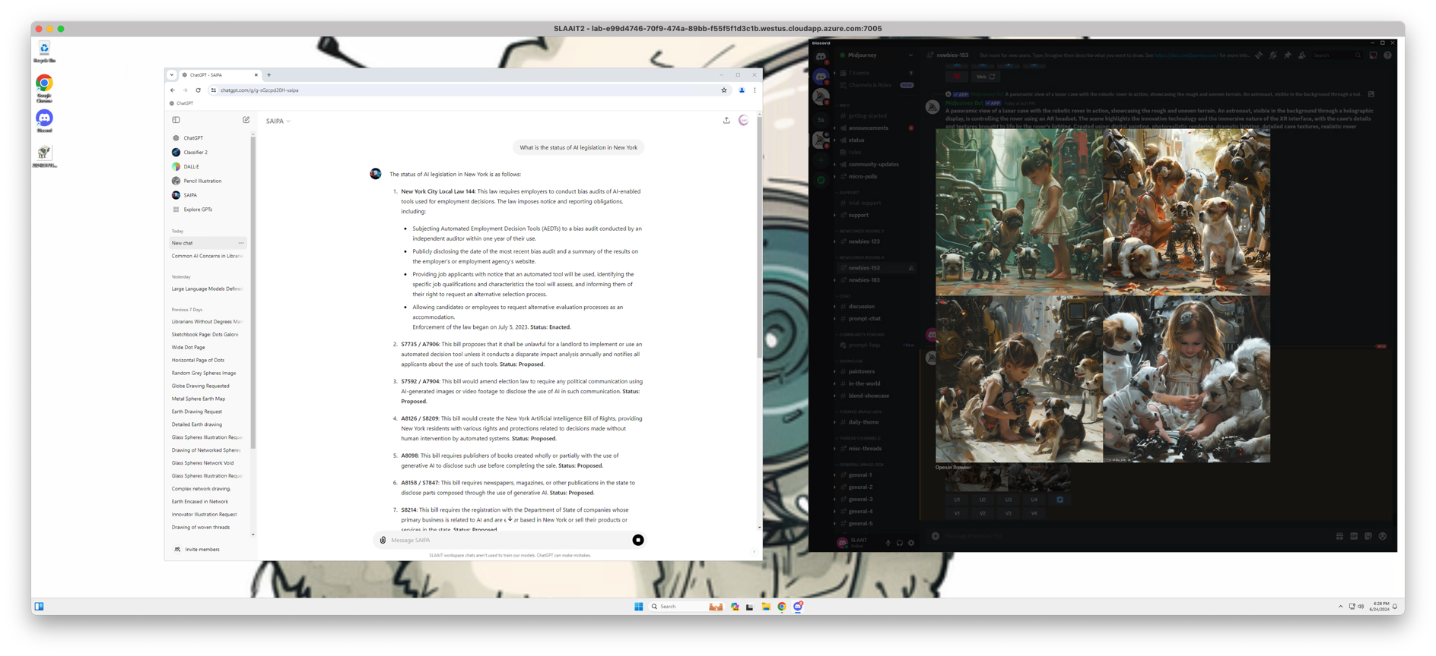
Azure Hosted Servcies

Slide 18
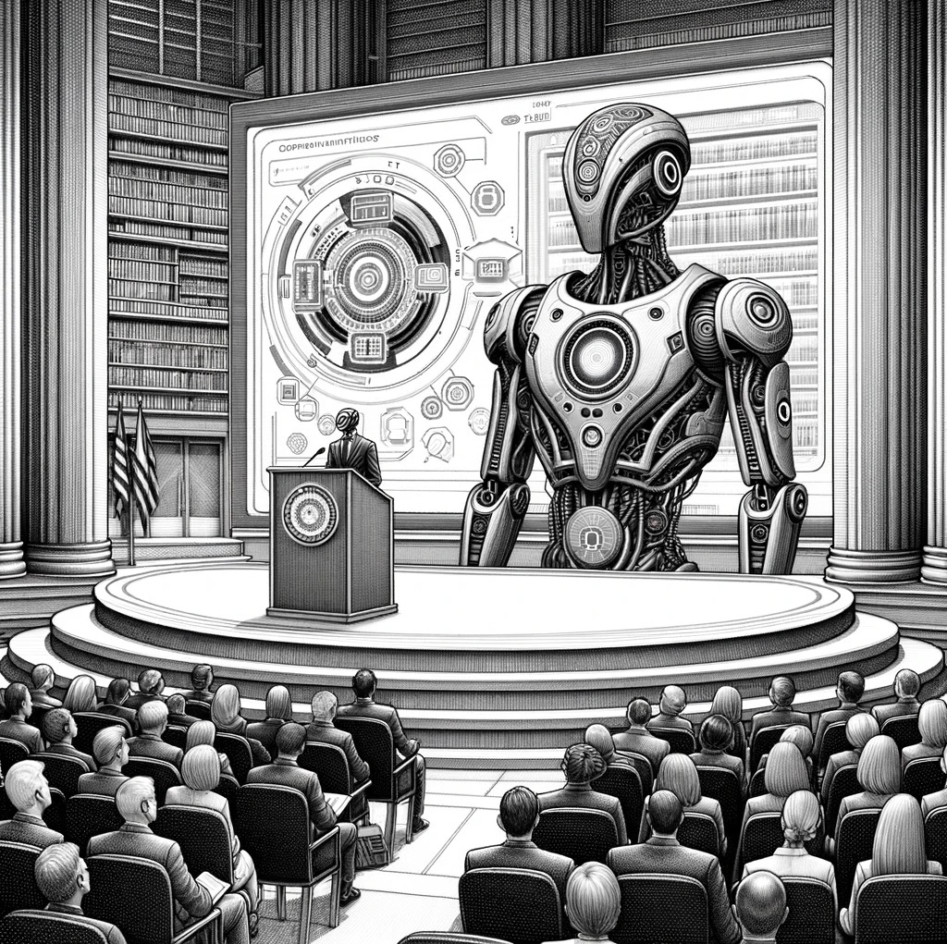
Synthesis

Slide 19
Multi-Tiered Reports
Level | Recommendations
Individual State Level | Learning Competencies and Matrices Project Ideas Tied to Strategies
Across Member State Libraries | Opportunities for Engagement (COSLA, IMLS, CIOs)
The Field | Advocacy for Appropriate Investment and/or Cautions
Special Populations | Rural Communities

Slide 20
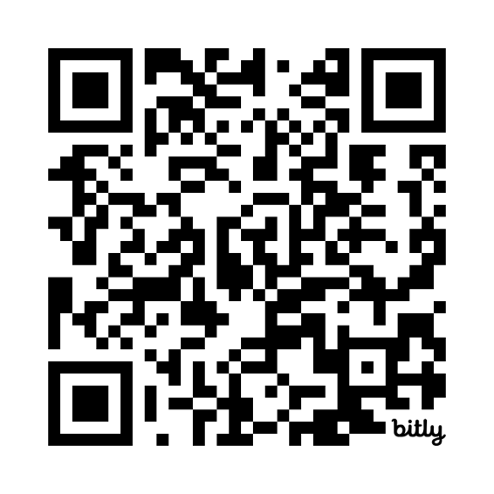
More Information
https://CIRCL.community

